Slide 1

The Speaking Gifts
1 Cor. 12:7-11; 1 Pet. 4:10-11;
Rom. 12:6-8; Eph. 4:11
Dr. Rick Griffith • Crossroads International Church Singapore
cicfamily.com & BibleStudyDownloads.org

Slide 2
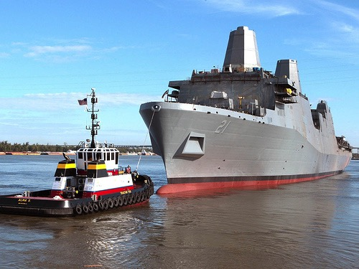
The Newest USN Ship
Notes:
I wonder how many of you have seen one of the newest US Navy ships christened on March 1.
This particular ship has several new features:
It was built with 24 tons of scrap steel
(THE POINT: God has remade our lives from brokenness: The USS New York with WTC steel parallels our destroyed lives made into Christ's body of which we are a part. See http://www.ussny.org/ and http://www.snopes.com/photos/military/ussnewyork.asp)

Slide 3
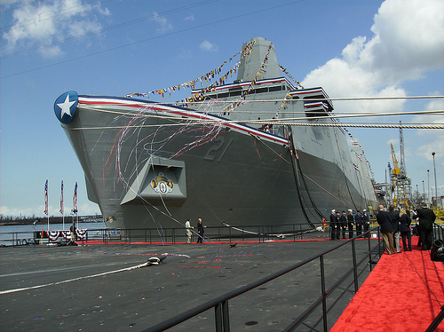
Docked
Notes:
It is the fifth in a new class of warship - designed for missions that include special operations against terrorists. It will carry a crew of 360 sailors and 700 combat-ready Marines to be delivered ashore by helicopters and assault craft.

Slide 4
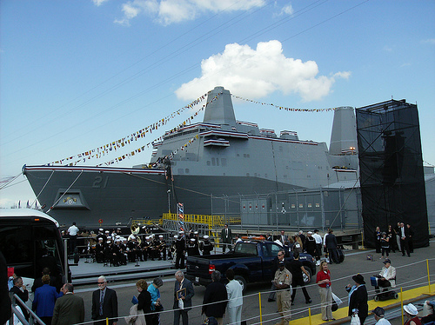
Made from WTC
Notes:
Definitely the most unique feature of this ship is that it is built entirely of scrap metal—and that metal comes directly from… yes, you guessed it—the Twin Towers in New York City!

Slide 5
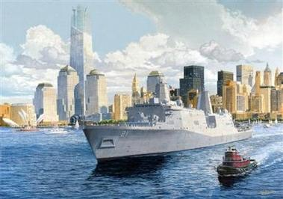
USS New York
Notes:
In fact, the ship is called the USS New York.
Of its 24 tons, 7.5 came from the World Trade Center and was melted down in a foundry in Avondale, LA to cast the ship's bow section.

Slide 6
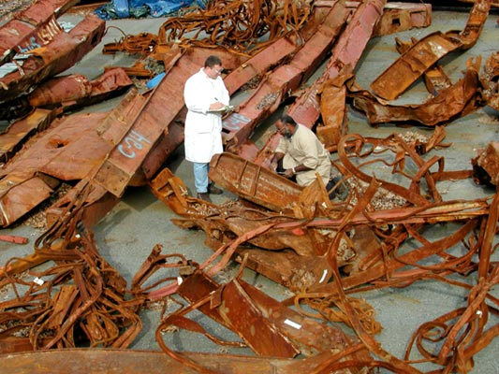
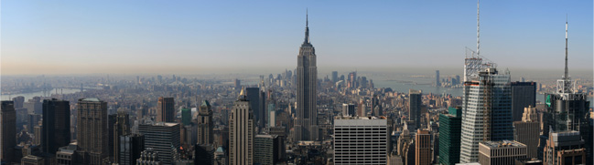
WTC Scraps
Notes:
Junior Chavers, foundry operations manager, said that when the trade center steel first arrived, he touched it with his hand and the 'hair on my neck stood up.' 'It had a big meaning to it for all of us,' he said. 'They knocked us down. They can't keep us down. We're going to be back.'

Slide 7
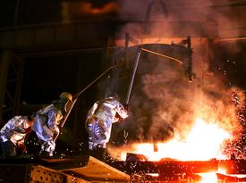
Amite Foundry
Notes:
When it was poured into the molds on Sept 9, 2003, 'those big rough steelworkers treated it with total reverence,' recalled Navy Capt. Kevin Wensing, who was there. 'It was a spiritual moment for everybody there.' Here three veteran employees of Amite Foundry open the ladle containing tons of molten steel from the World Trade Center.

Slide 8
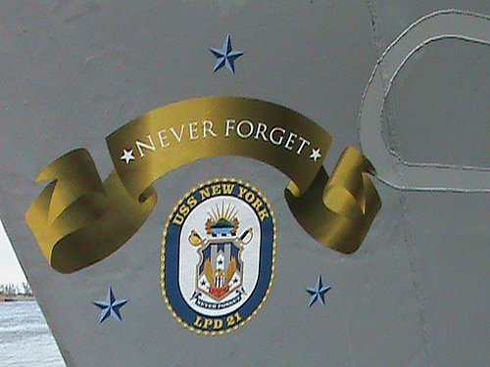
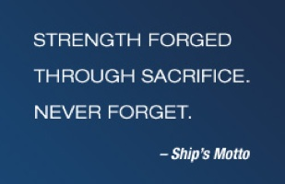
Never Forget
Notes:
The ship's motto is blazoned on the side: “Never Forget'!” It will officially be commissioned in NYC in Fall 2009.

Slide 9

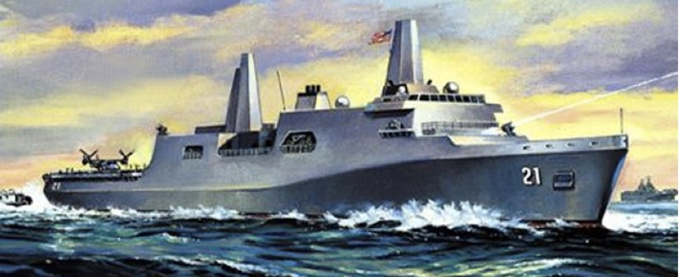
Parallels
Notes:
1. As I thought about the upcoming seventh commemoration of 9/11 and this ship made from remnants of destruction, the parallel to our lives as Christians really hit me.
a) Like the Twin Towers, we also were made beautiful for a grand purpose in Eden.
b) Like those Twin Towers, we also became remnants of destruction back in Eden.
c) Like the World Trade Center recycled into a useful vessel against aggressors, so as believers in Christ, He has made us a new body in Christ to battle the enemy.
Each part of that ship has a specific purpose; likewise, because we are in Christ, the Holy Spirit has assigned each of us a new role to play in the body of Christ.

Slide 10

How do you see the Spirit working in your life?
Notes:
Intro to MPI: But do you identify with this? How do you see the Spirit working in your life?

Slide 11
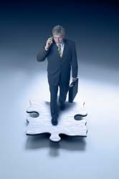

I. One evidence of the Spirit's work in your life is your spiritual gift
(1 Cor. 12:7-11)
“A spiritual gift is given to each of us so we can help each other” (1 Cor. 12:7 NLT)

Slide 12

Spiritual Gifts
An Introduction

Slide 13
Crossroads Spiritual Gifts Results
63
 | Teach | Evan | Pastor | Exhort | Admin | Faith | Giving | Service | Mercy
Rick | 1 | 7 | 2 | 4 | 2 | 9 | 5 | 6 | 8
Susan | 2 | 9 | 4 | 5 | 8 | 6 | 7 | 1 | 3
Lewis | 1 | 5 | 3 | 2 | 3 | 8 | 7 | 5 | 8
Barbara | 3 | 1 | 4 | 5 | 8 | 7 | 6 | 9 | 2
Leland | 3 | 9 | 8 | 7 | 6 | 5 | 1 | 4 | 2
Linda Calhoun | 8 | 9 | 4 | 5 | 2 | 7 | 6 | 1 | 3
Andrew | 5 | 8 | 5 | 3 | 2 | 8 | 7 | 1 | 4
Adrielle | 5 | 9 | 4 | 6 | 8 | 7 | 2 | 3 | 1
Valentin | 3 | 9 | 5 | 5 | 2 | 8 | 7 | 1 | 4
Jieun | 8 | 7 | 9 | 6 | 5 | 2 | 3 | 1 | 4
Bal | 8 | 9 | 3 | 6 | 1 | 7 | 4 | 5 | 2
Carol | 6 | 4 | 1 | 1 | 5 | 9 | 8 | 7 | 3
Drew | 1 | 3 | 5 | 7 | 7 | 6 | 2 | 4 | 9
Linda Fones | 7 | 9 | 5 | 6 | 1 | 3 | 8 | 2 | 4
Robert | 6 | 4 | 1 | 6 | 2 | 4 | 9 | 8 | 2
Geeta | 1 | 2 | 4 | 7 | 8 | 8 | 6 | 3 | 5
Net Scores of 1 | 4 | 1 | 2 | 1 | 2 | 0 | 1 | 5 | 1

Slide 14
Crossroads Spiritual Gifts Results
63
 | Teach | Evan | Pastor | Exhort | Admin | Faith | Giving | Service | Mercy
Singpu | 2 | 1 | 3 | 8 | 4 | 7 | 5 | 9 | 6
Kim | 5 | 7 | 4 | 5 | 9 | 8 | 3 | 2 | 1
Athan | 1 | 3 | 5 | 7 | 2 | 5 | 9 | 4 | 8
Chanchan | 4 | 9 | 8 | 7 | 5 | 6 | 2 | 1 | 3
Albina | 1 | 1 | 5 | 3 | 6 | 9 | 8 | 7 | 3
Désirée | 1 | 3 | 2 | 4 | 6 | 7 | 8 | 9 | 5
Jonathan | 5 | 4 | 2 | 3 | 6 | 7 | 9 | 7 | 1
Eva | 6 | 9 | 7 | 3 | 1 | 3 | 3 | 2 | 7
Deborah | 3 | 8 | 3 | 4 | 1 | 9 | 3 | 2 | 3
Miriam | 7 | 8 | 2 | 3 | 1 | 5 | 4 | 5 | 8
Shannah | 6 | 7 | 3 | 2 | 6 | 7 | 7 | 3 | 1
Tessa | 7 | 6 | 1 | 1 | 9 | 8 | 5 | 1 | 4
Sean | 6 | 6 | 8 | 9 | 1 | 5 | 2 | 4 | 2
Arun | 9 | 8 | 6 | 5 | 7 | 2 | 3 | 4 | 1
Net Scores of 1 | 3 | 2 | 1 | 1 | 4 | 0 | 0 | 2 | 4
First Slide | 4 | 1 | 2 | 1 | 2 | 0 | 1 | 5 | 1
Total Scores of 1 | 7 | 3 | 3 | 2 | 6 | 0 | 1 | 7 | 5

Slide 15
The Wayward Local Church
The Wayward Local Church
Reports
Questions
Division
Disorder
Difficulties
Concern
1–4
Discipline
5–6
Instruction
7–16
Carnality
3–4
Marriage 7
Worship
11–14
Factions 1–2
Incest 5
Idols 8–10
Resurrection
15
Immorality
Collection 16
Lawsuits 6
Solving church problems theologically

Slide 16
The Triune Involvement
EMPOWERS
Father
is
is not
is not
GOD
is
is
Son
Spirit
APPOINTS
GIVES
is not
H. Wayne House, Charts of Christian Theology and Doctrine, 45

Slide 17

The Spirit gives every gift (8 NLT)
⁸To one person the Spirit gives the ability to give wise advice [a word of wisdom]; to another the same Spirit gives a message of special knowledge [a word of knowledge].*

Slide 18
The Spirit gives every gift (9-10a)
⁹The same Spirit gives great faith to another, and to someone else the one Spirit gives the gift of healing. ¹⁰He gives one person the power to perform miracles.

Slide 19
The Spirit gives every gift (10b-11a)
and another the ability to prophesy. He gives someone else the ability to discern whether a message is from the Spirit of God or from another spirit. Still another person is given the ability to speak in unknown languages,* while another is given the ability to interpret what is being said. ¹¹It is the one and only Spirit who distributes all these gifts.

Slide 20
The Spirit alone chose the gift you got (11b)
He alone decides which gift each person should have.

Slide 21
I. One evidence of the Spirit's work in your life is your spiritual gift
(1 Cor. 12:7-11)
“A spiritual gift is given to each of us so we can help each other” (1 Cor. 12:7 NLT)

Slide 22
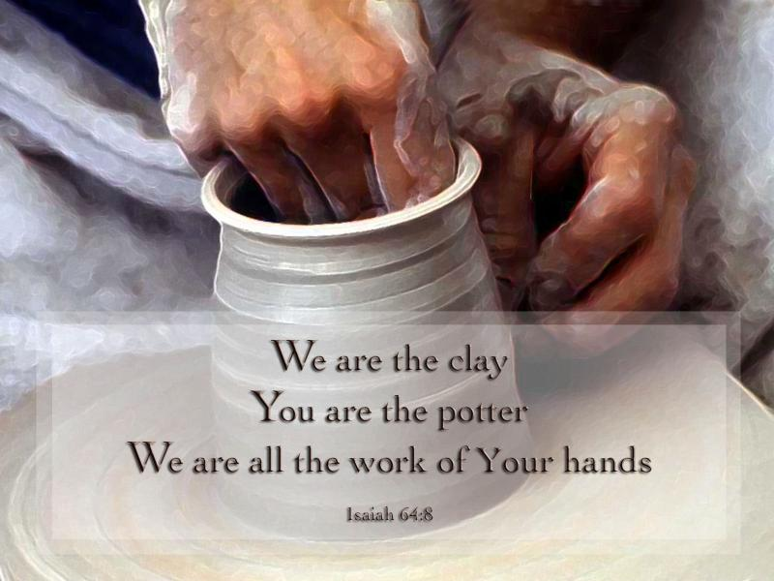
II. We should use our gifts by speaking for God or serving in His strength (1 Pet. 4:10-11).

Slide 23

1 Peter 4:10 (NIV)
“Each one should use whatever gift he has received to serve others, faithfully administering God's grace in its various forms.”

Slide 24
1 Peter 4:11 (NIV)
“If anyone speaks, he should do it as one speaking the very words of God. If anyone serves, he should do it with the strength God provides, so that in all things God may be praised through Jesus Christ. To him be glory forever and ever. Amen.”

Slide 25

Categories of Gifts
(1 Peter 4:11)
Get
words
from
God
Get
strength
from
God
47
Speaking | Serving
Teaching | Administering
Evangelism | Faith
Pastor-Teacher | Giving
Encouraging | Service
 | Mercy
Notes:
25

Slide 26

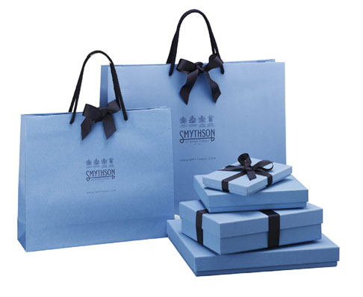

III. God gave some believers a speaking gift to be His special voice
I know. That's why I share my faith!
God says to use your gift
We use our mouths for Him too!

Slide 27
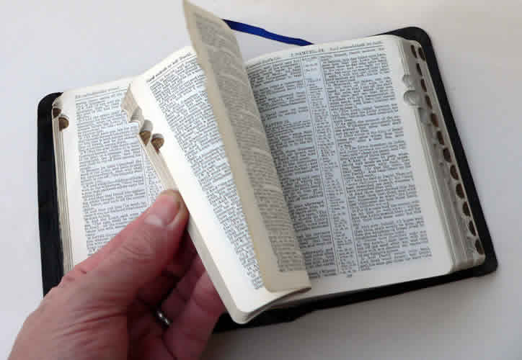
Romans 12:6-7 NLT
⁶In his grace, God has given us different gifts for doing certain things well. So if God has given you the ability to prophesy, speak out with as much faith as God has given you.
⁷If your gift is serving others, serve them well. If you are a teacher, teach well.

Slide 28

Teaching
49
"All Scripture is inspired by God and is useful to teach us what is true and to make us realize what is wrong in our lives. It corrects us when we are wrong and teaches us to do what is right. ¹⁷God uses it to prepare and equip his people to do every good work"
(2 Tim. 3:16-17 NLT)

Slide 29
Black

Slide 30

Defining “Teaching”
49
“The ability to communicate the Scriptures with clarity, ease, wisdom, and efficiency… explains God's Word with understanding"
(Swindoll, 4)

Slide 31
Black

Slide 32
Serve in proportion to your faith (Rom. 12:3 NLT)
"Because of the privilege and authority God has given me, I give each of you this warning: Don’t think you are better than you really are. Be honest in your evaluation of yourselves, measuring yourselves by the faith God has given us."

Slide 33
Romans 12:8 NLT
⁸If your gift is to encourage others, be encouraging.

Slide 34

Encouragers should encourage others to apply God’s Word (8a)
53

Slide 35

Exhortation
53
Also called the gift of encouragement

Slide 36
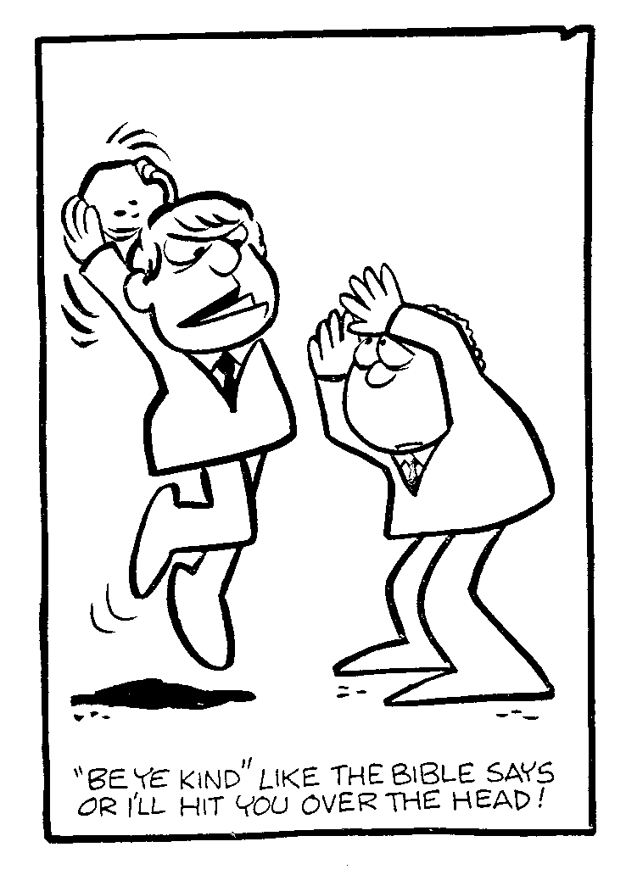
Exhortation?
"Be ye kind" like the Bible says or I'll hit you over the head!

Slide 37
Defining “Encouraging”
“While the teacher communicates facts and truths of the Word of God, the exhorter is able to encourage the hearer to act upon that which he has heard. The teacher gives the what of the Scripture, while the exhorter gives the how”
(Swindoll, 4)

Slide 38
Black

Slide 39

What are encouragers like?
Action steps
Application
Optimism
Believes in you

Slide 40
Joseph in Acts
Barnabas: "Son of Encouragement"
Barnabas endorsed Saul, an unwelcome convert (Acts 9:26-28; Gal. 2:9)
Barnabas accepted alien believers, the Gentiles (Acts 11:19-24)
Barnabas enlisted and developed Paul, a promising teacher (Acts 11:25-26; 12:25; 13:42ff)
Barnabas restored Mark, the youthful deserter (Acts 13:13; 15:36-41; 2 Tim. 4:11)

Slide 41
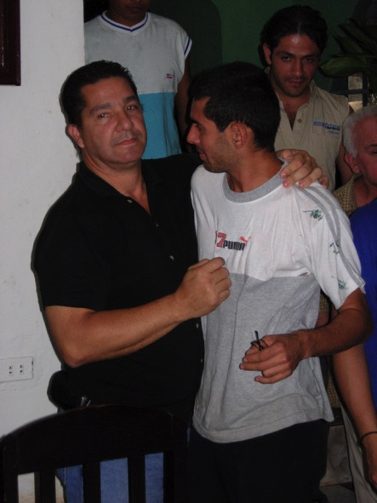
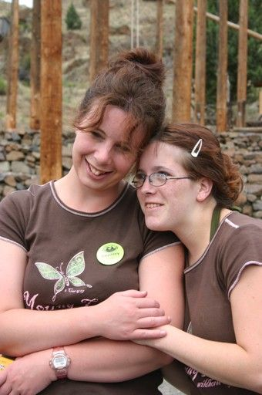

How are you doing at encouraging?
53

Slide 42

Life Transformation Groups
The Commitment: Meet one hour a week with 1-2 others of the same sex to provide accountability to:
Read 3 Bible chapters daily
Confess sin around 10 questions
Pray for lost friends

Slide 43


Discipleship

Slide 44



Life Transformation Groups

Slide 45
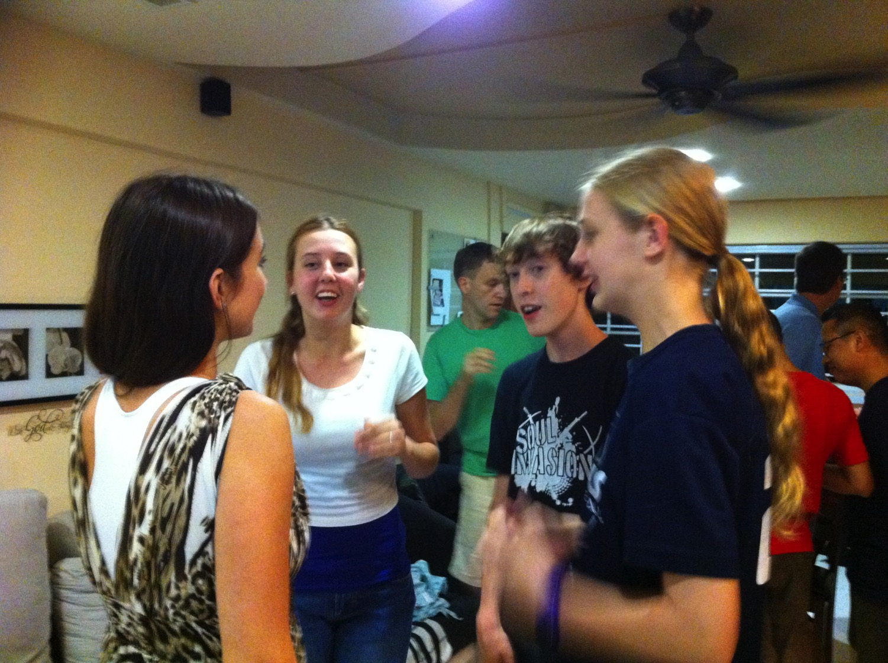
Invest in our youth!

Slide 46
Ephesians 4:11 (NIV)
It was he who gave
some to be apostles,
and some to be prophets,
and some to be evangelists,
and some to be pastors and
teachers.

Slide 47

1. Evangelists reach people for Christ
50

Slide 48
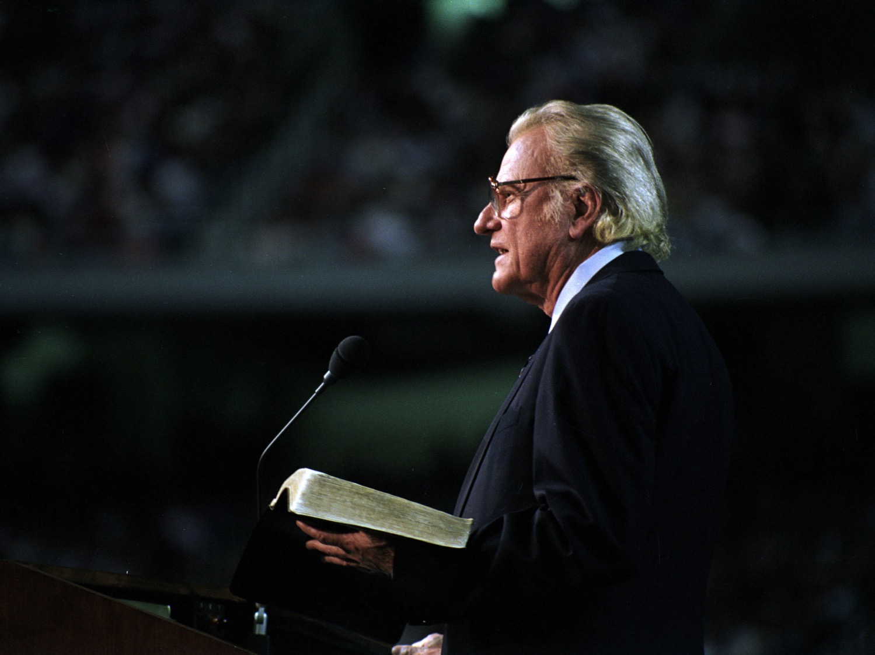
Evangelists
Is Billy Graham the standard?

Slide 49
Black

Slide 50

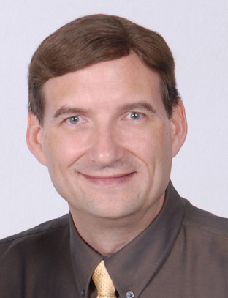
2. Evangelists equip the church to reach the lost (Eph 4:11)
Dr Dave Geisler
President
Meekness & Truth Ministries

Slide 51
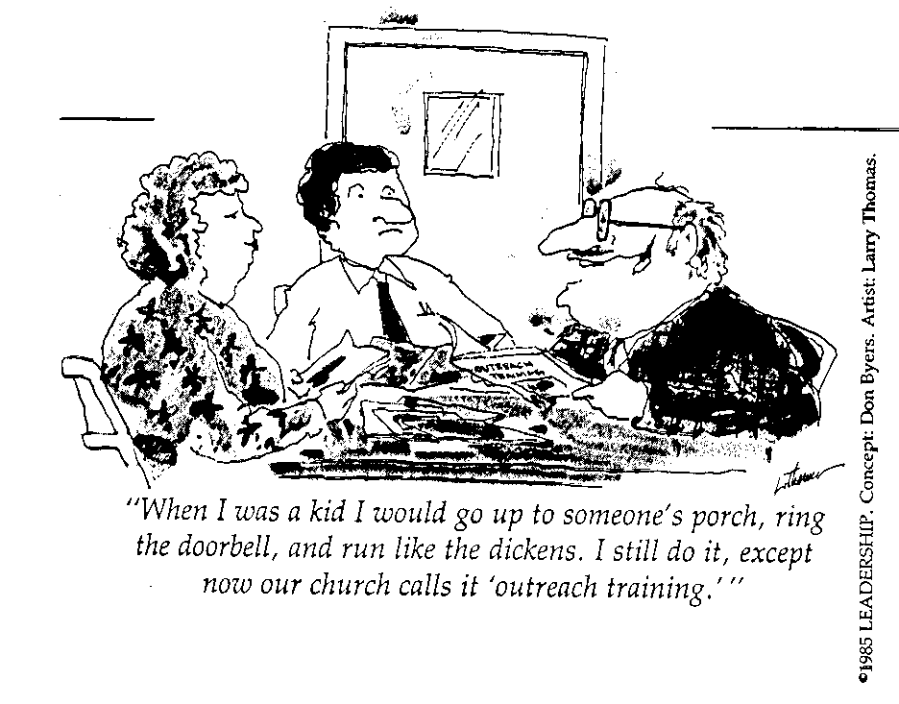
Many Fear Evangelism!
"When I was a kid I would go up to someone's porch, ring the doorbell, and run like the dickens. I still do it, except now our church calls it 'outreach training.'"

Slide 52
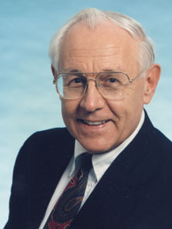
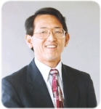
Pastor-Teachers
52
Too often we think only of those with the position of pastor-teacher

Slide 53
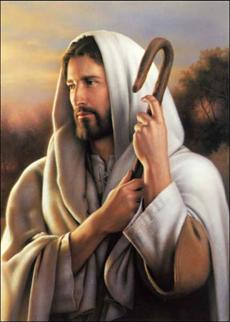
Christ is the Good Shepherd

Slide 54
The Dual Gift
And He gave
some, apostles;
and (de) some, prophets;
and (de) some, evangelists;
and (de) some, pastors and (kai,) teachers
[
[

Slide 55
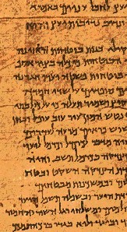
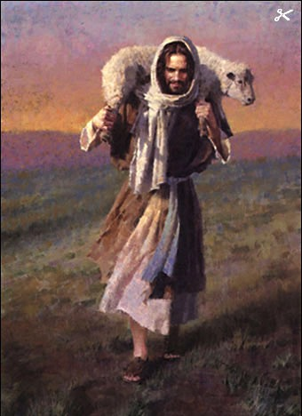
The Only “Dual” Gift
52
Pastor
Teacher
Protection
Study
Discipline
Instruction
Leading
Applying
Caring
Warning

Slide 56
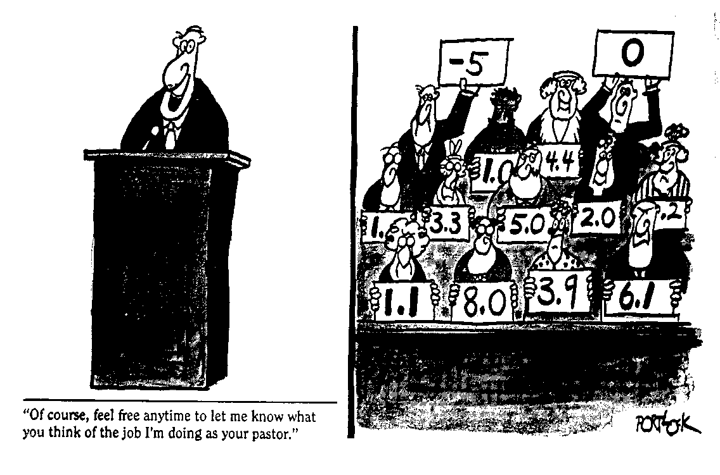
Toughest Job in the World
“Of course, feel free anytime to let me know what you think of the job I'm doing as your pastor.”

Slide 57
Ephesians 4:11-12 (KJV mistranslation)
v. 11
KJV
And He gave
some, apostles;
and (de) some, prophets;
and (de) some, evangelists;
and (de) some, pastors and (kai,) teachers
v. 12
KJV
for (pro,j) the perfecting of the saints,
for (ei,j) the work of the ministry,
for (ei,j) the edifying of the body of Christ.
This implies the gifted men do all three ministries!

Slide 58

Ephesians 4:11-12 (NASB)
v. 11
NASB
And He gave
some as apostles,
and (de) some as prophets,
and (de) some as evangelists,
and (de) some as pastors and (kai,) teachers.
v. 12
NASB
for (pro,j) the equipping of the saints
for (ei,j) the work of service
to (ei,j) the building up of the body of Christ.
God gave gifted men to train others to do ministry!

Slide 59
Ephesians 4:11-12 (NIV)
v. 11
NIV
It was he who gave
some to be apostles,
and some to be prophets,
and some to be evangelists,
and some to be pastors and teachers.
v. 12
NIV
to prepare God's people
for works of service
so that the body of Christ may be built up.
God gave gifted men to train others to do ministry!

Slide 60
Black

Slide 61
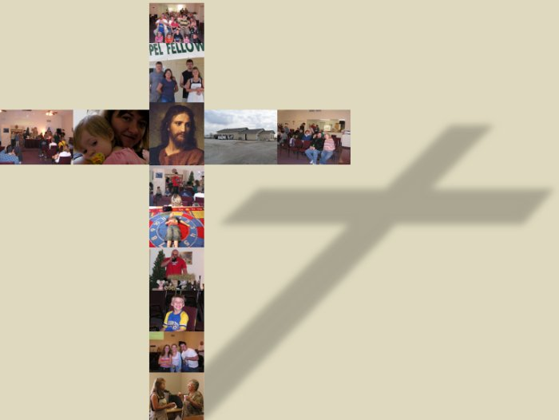
The Main Idea
If you have a speaking gift, then talk as God's voice

Slide 62
Speaking Gifts Contrasted
47
 | Teaching | Evangelism | Pastor-Teacher | Exhortation
Shares | Biblical Learning | Faith & Testimony | Heart & Bible | Optimism
Recipient Need Met | Scriptural Truth | Salvation & Equipping for Evangelism | Shepherding | Encouragement
Sensitive to Needs | Doctrinally | For Conversion | Spiritually (overall needs) | Spiritually (specific needs)
Ministers to Those Needing | Instruction | Saving Faith | General Spiritual Direction | Urging in Practical Steps
General Trait | Accuracy in the Word | Heart for the Lost | Shepherd Heart | Uplifts Others

Slide 63

Scriptural Gift Commands
4
Teaching
Col. 3:16-- “Let the word of Christ richly dwell within you… teaching… one another…”
Evangelism
Matt. 28:19-- “Go therefore and make disciples of all nations…”
Pastor-
Teacher
Gal. 6:1-- “Brothers, if a man is caught in any trespass, you who are spiritual, restore him…”
Exhortation
Heb. 3:13a-- “But encourage one another daily…”

Slide 64
1 Peter 4:11 (NIV)
“If anyone speaks, he should do it as one speaking the very words of God.”

Slide 65
Black

Slide 66


NT Preaching link at BibleStudyDownloads.org
Get this presentation and script for free!
Notes:
NT Preaching (np)

